Slide 1
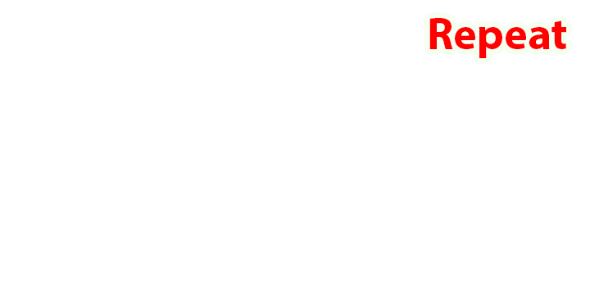
Presented by:
RAKESH REDDY JAMMULADinne
PRAVEEN KUMAR NEETHIPUDI
MANI KUMAR VAKATI
MANI SRIDHAR Kambhampati
SUNNY MUKESH KOLATI

Slide 2
TABLE OF CONTENTS
Proposed System
Tools Used
Modules in Project
Project Overview
Advantages
Limitations
Conclusion

Slide 3

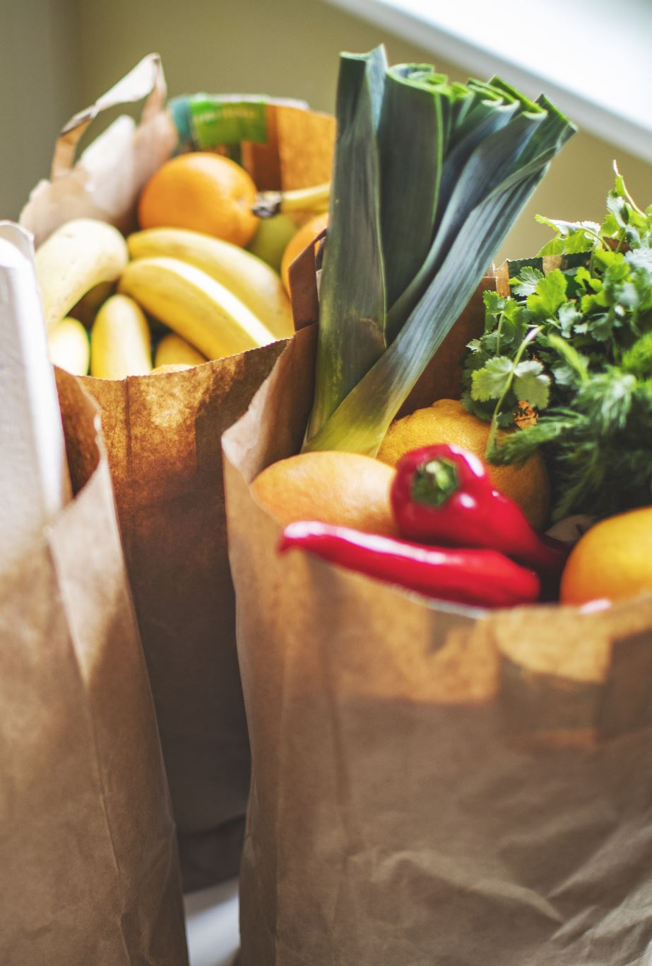
PROPOSED SYSTEM
Repeat has instant delivery and is regarded as quick commerce. It fulfills grocery delivery within 10 mins and We deliver wide variety of groceries and we had wide range of our network established in different places.

Slide 4

TOOLS USED/IDE USED
Tools:-
MYSQL(Version 8.0)
Spring Boot(Version 2.6.6)
Angular(version 16)
IDE:
Visual Studio Code(IDE)

Slide 5
MODULES IN PROJECT
Welcome Component
Repeat Component(Home Component)
Registration Component
Login Component
Product Component
Add Product Component
User Product List Component
Add To Cart Component
Buy Now Component
Payment Component

Slide 6

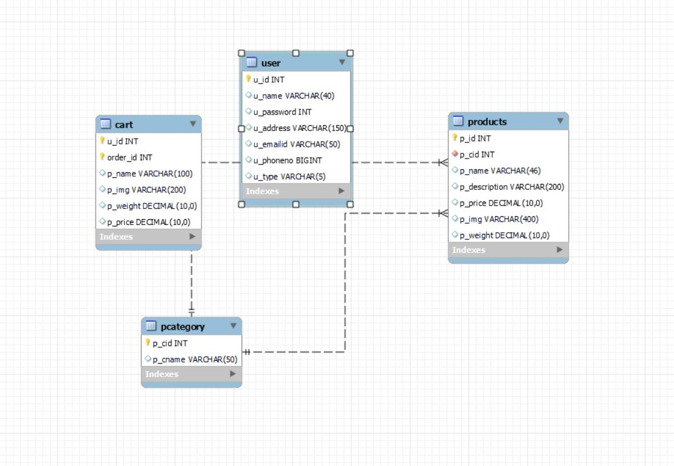



ER DIAGRAM

Slide 7
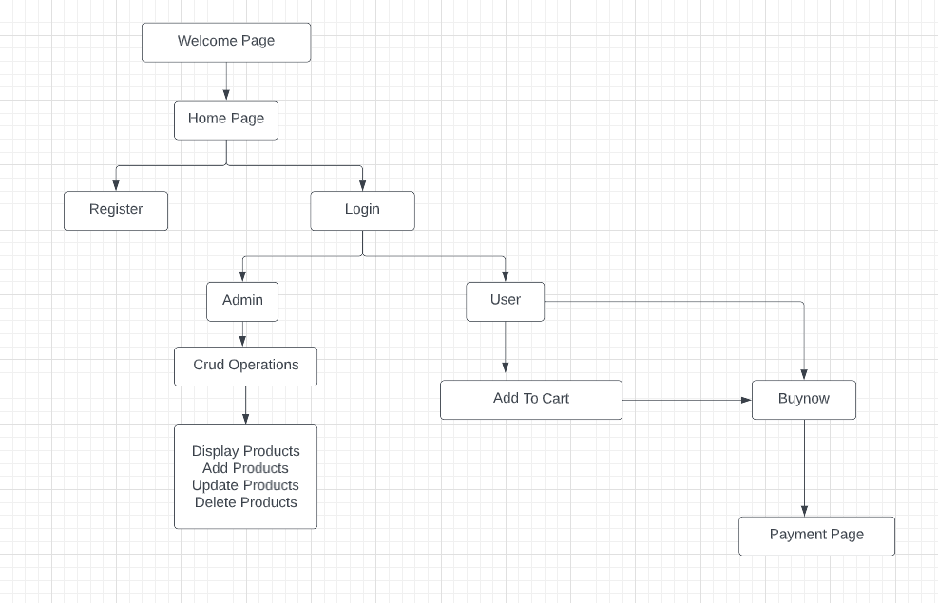
FLOW CHART OF PROJECT

Slide 8
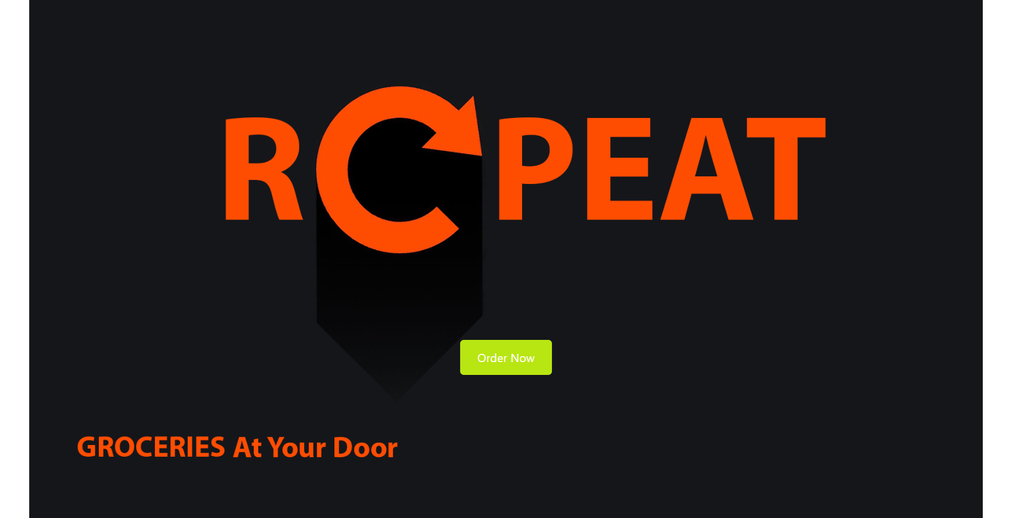
WELCOME PAGE

Slide 9
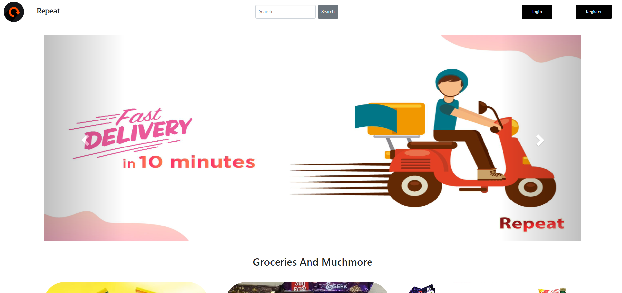
HOME PAGE

Slide 10
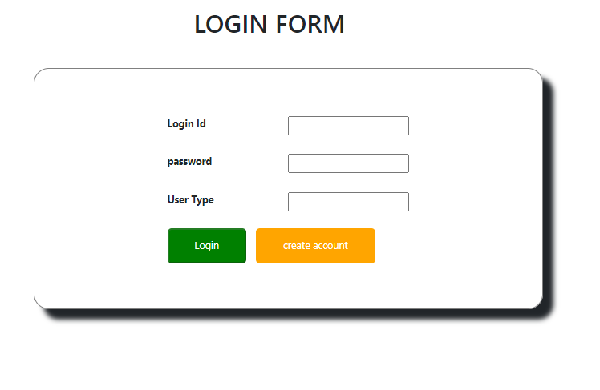
LOGIN PAGE

Slide 11
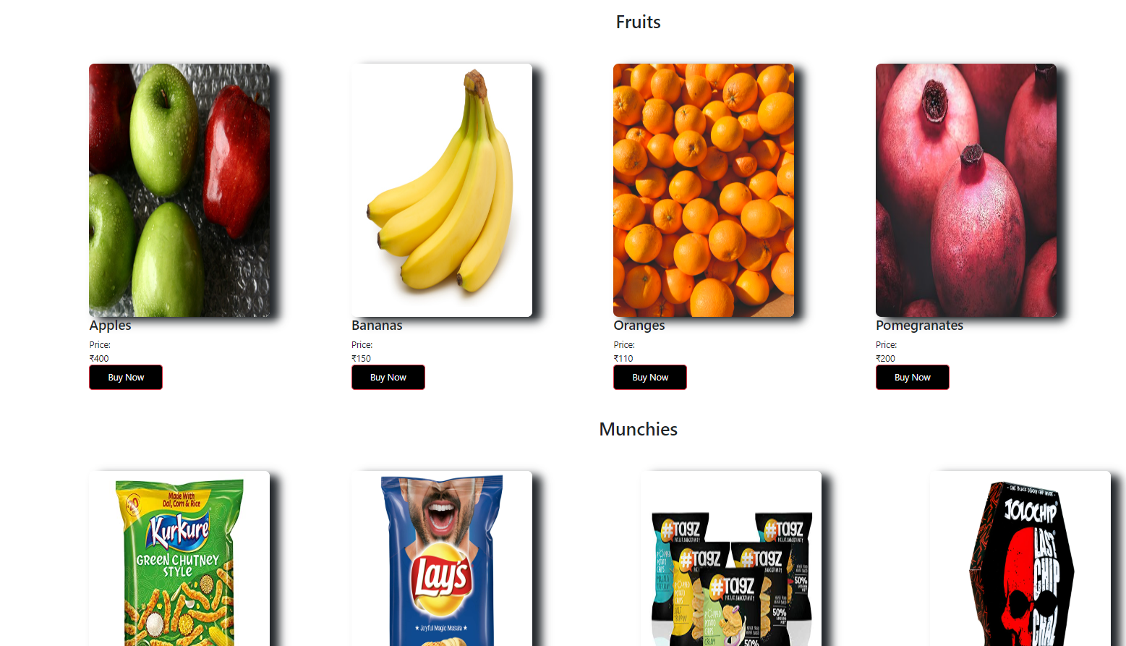
PRODUCT PAGE

Slide 12

ADVANTAGES
Improved Delivery And Quicker Distribution.
Contactless Shopping.
Enhanced Inventory Management And Better Product Selection.

Slide 13
LIMITATIONS
No proper age verification. As per the terms and conditions of this app, children below 13 should not create an account on this platform.
There can be additional cost for delivery services.

Slide 14

CHALLENGES
We faced much time on getting data and images.
Validations logic
Faced issues during spring to angular connections
Front end designing part.

Slide 15

Thank you

